Slide 1
Blackwell electronics' data mining efforts
Sergio Robledo

Slide 2
Overview: insights gained & Questions answered
Gain insight into whether customers had a preference between Sony & Acer computers.
Check if correlation exists between customer reviews and product sales volume.
Used…
Product Star Review Ratings
Positive / Negative Customer Service Reviews
Predict new product sales volume based on four product types.
PC, Netbook, Laptop and Smartphone
Electronidex Market Basket Analysis & Advice
Recommendation model using transactional history

Slide 3
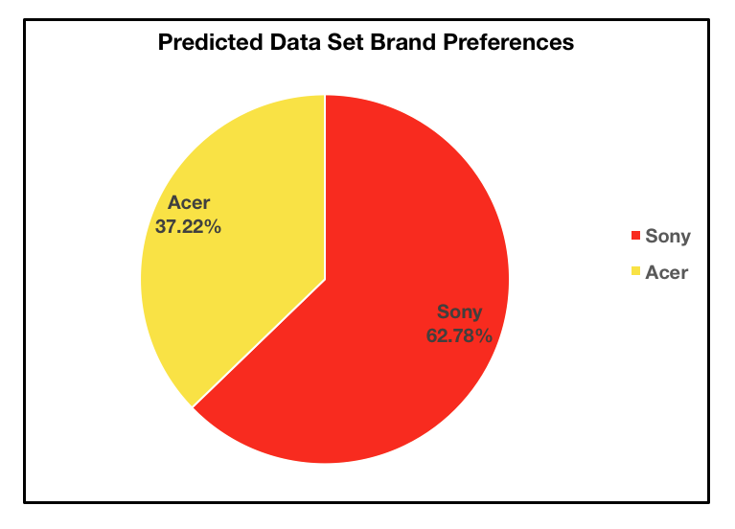
Sony & Acer computer sales comparison
Preference Exists
Sony ≈ 63%
3,139 / 5,000 Customers
Predicting Factors
Salary
Strongest Predictor
Minimum: $20,000.00
Maximum: $150,000.00
Average: $85,118.02
Age
Prediction Model & Accuracy
Random Forest
About 90.54% accuracy

Slide 4
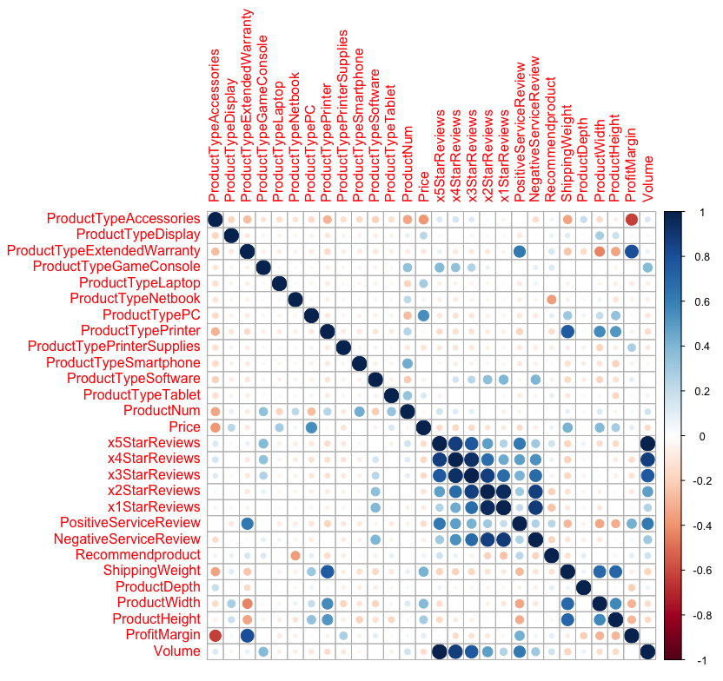
Customer Reviews & Sales volume
Strongest Influence on Sales Volume
5 Star Product Reviews
Plot Illustrates Correlations
Dark Blue Indicates Strong Positive Correlation (Desirable)
Dark Red Indicates Correlation BUT…
Red indicates customer avoids product
Columns: Product Features
Secondary Influences (decreasing impact)
4 Star Product Reviews
3 Star Product Reviews
Positive Customer Service Review
2 Star Product Reviews
Negative Customer Service Review
1 Star Reviews
Sales Volume

Slide 5
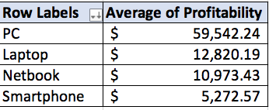
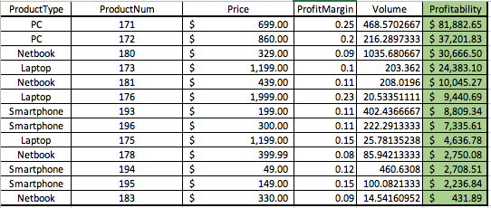
Product type, Sales volume & Profitability
Product Types: PC, Laptop, Netbook and Smartphones
Important Features
Product Type
Customer Reviews
Product Star Reviews
Customer Service Reviews
Profitability = Sales Volume * Price * Profit Margin
Most Profitable: Product # 171 (PC)
Product Type Profitability Average
PC Highest Profit Average by $45k+
Confidence Level of Accurate Predictions
About 95% Accurate
Random Forest Prediction Model Used

Slide 6
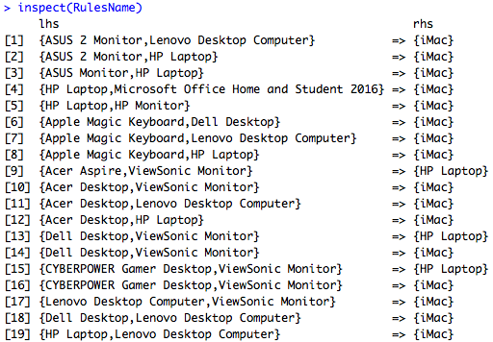
Electronidex’s Transactions, Market Basket Analysis & Acquisition
Market Basket Analysis ⇢ Recommendation System
Based on Transaction History (Items Bought Together)
Data: 9,835 Transactions (1 Month)
50% Transactions ≥ 3 Items per Transaction
iMac sold in 2,519 Transactions (25.6%)
Created 19 Recommendation Rules
Min. of 50% Customers Bought Recommended Product
Recommendations Regarding Electronidex
Acquire Electronidex due to High Sales Volume
Always Recommend iMac ( ¼ of Customers Will Buy)
Use Recommendation System
Keep Adding Data
Stronger Recommendation System

Slide 7
Useful Future Data MINING APPLICATIONS FOR Blackwell Electronics
Predict what Companies Might Flourish if Acquired by Blackwell
Collect a lot of data
Collect detailed data
Example: Years of Experience of Company’s CEO
Gain Insight into what Factors Motivates Employees to Stay / Leave the Company
Possible factors could include salary, age, department…
Determining Most Effective Way of Attracting New Customers
Examples: Newspaper Ads, Online Ads, Social Media…
What Website Design Leads to More Sales

Slide 8

Lessons Learned: task 1
Task 1: Get Started with R
First time downloading and using R
As well as Rstudio
R syntax
R syntax is very similar to Python syntax
Learned Basic Commands in R
Learned how to set the R directory to my desktop

Slide 9
Lessons learned: Task 2
Task 2: Classification: Predict which Brand of Products Customers Prefer
Caret Pipeline
Used caret Pipeline provided to build my first prediction process
Prediction Models
Random Forest & Linear
Performance Metrics: How to evaluate & choose models
R-Squared, RMSE
Results
How to present results in a non-technical way
Simple Graphs
Able to give confidence level in my results

Slide 10
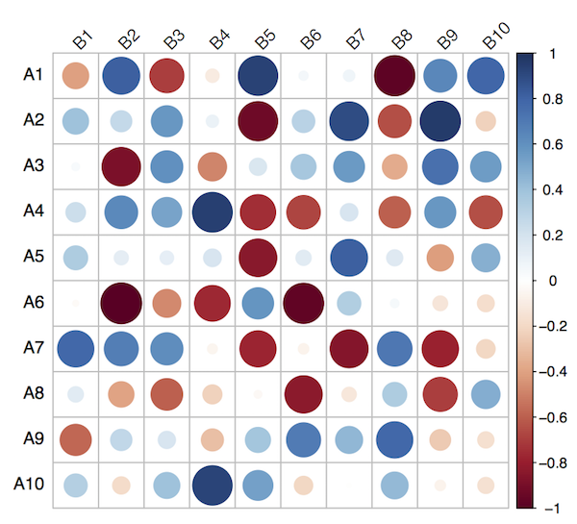
Lessons Learned: Task 3
Task 3: Multiple Regression in R
Dummy Variables
Changing Character/Factor variables to Binary Variables
Correlation
Correlation doesn’t imply Causation
Correlation Plot
Parametric vs Non-Parametric Models
Parametric: Assume Normal Distribution
Usually High Data Values
Non-Parametric: Skewed Distributions
Tend towards Lower Data Values given

Slide 11
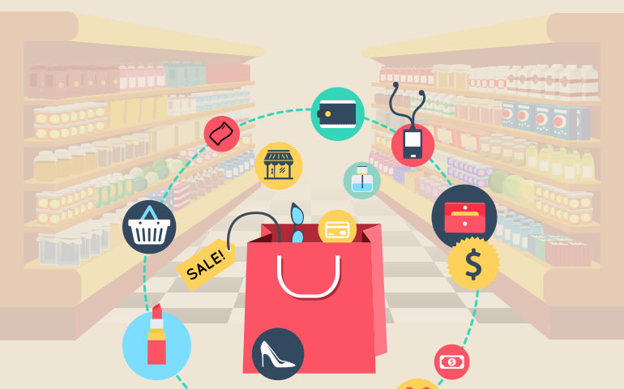
Lessons Learned: Task 4
Task 4: Discover Associations Between Products
How to read transactional data in R
arules Package
Analyze Transactions
arulesViz Package
Visualize Transaction
How to Perform a Market Basket Analysis
Apriori Algorithm
Unsupervised Learning Model
Creates Item Set Rules
How to Evaluate Rules created by the Apriori Algorithm
Support: How many times Rule appears in Transactions
Confidence: Out of the times the Rule appears in the Transaction…
how many follow the rule?
Lift: Importance of Rule
Not due to chance

